Slide 1
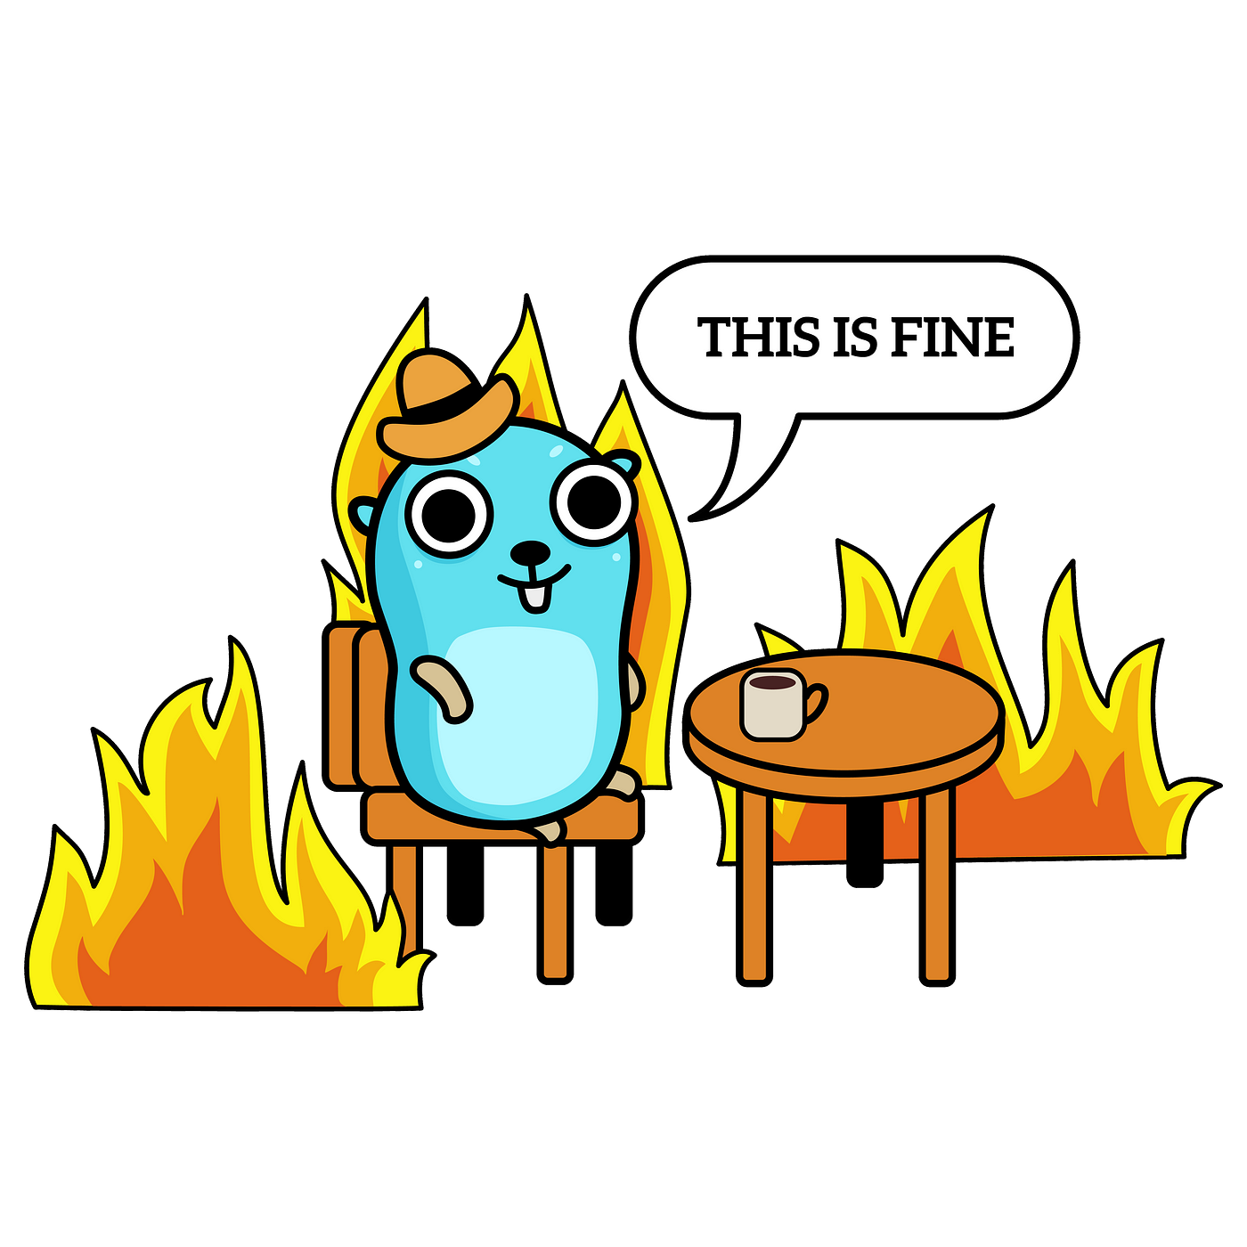
Errors in Go
Michał Gosek

Slide 2

Agenda
Software error 👾
Exceptions 👀
Exceptions - code example 💾
Exceptions vs no exceptions 🤔
Defer, Panic & Recovery 😱
Errors in
Built in examples 🏗
Errors package API 📖
Assertions 👮🏻‍♂️
Code example 💾
References 📚

Slide 3
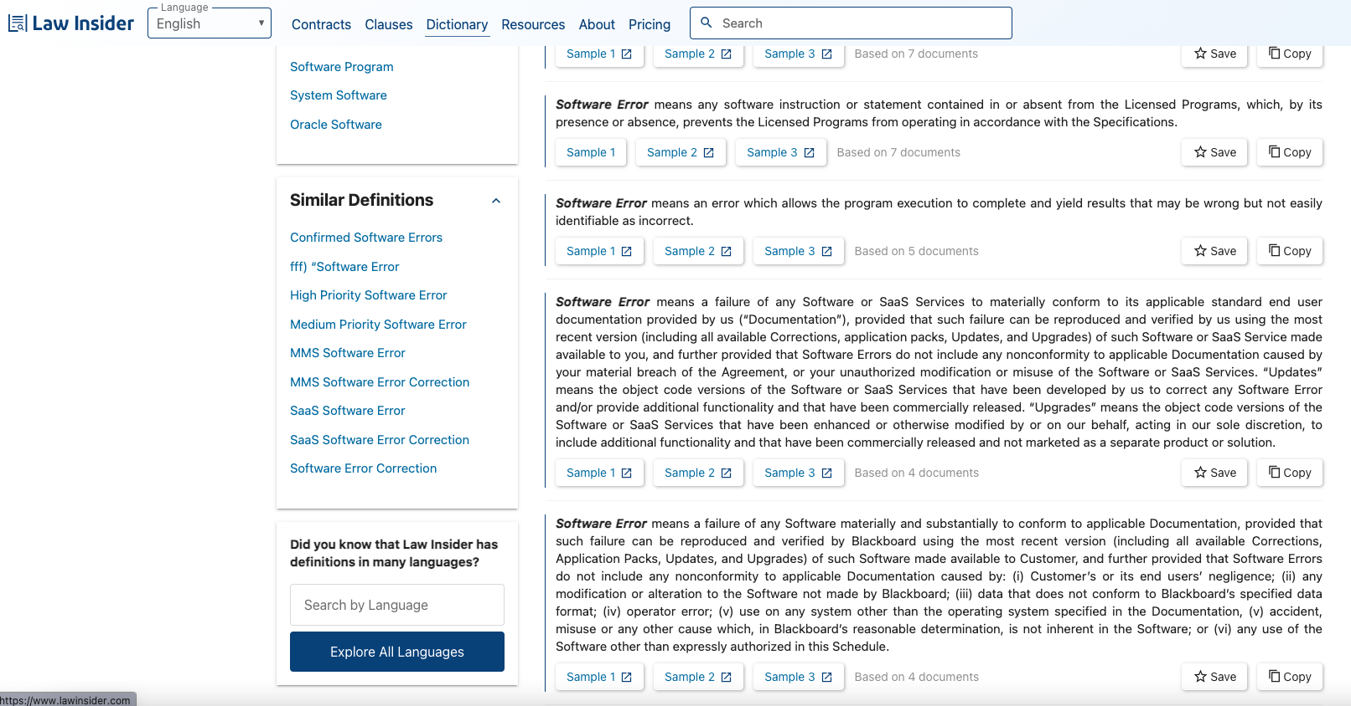
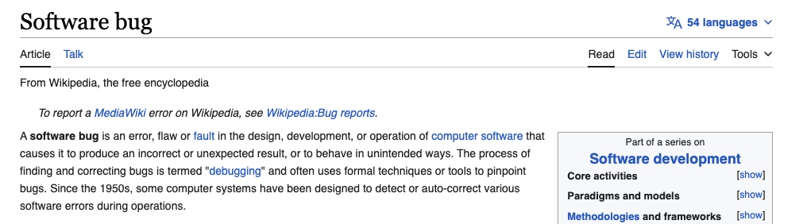
Software error 👾

Slide 4
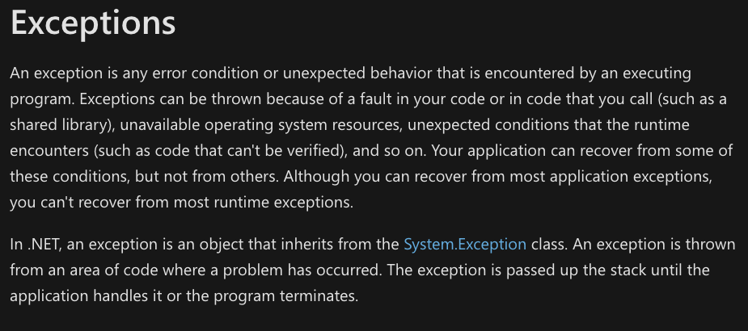
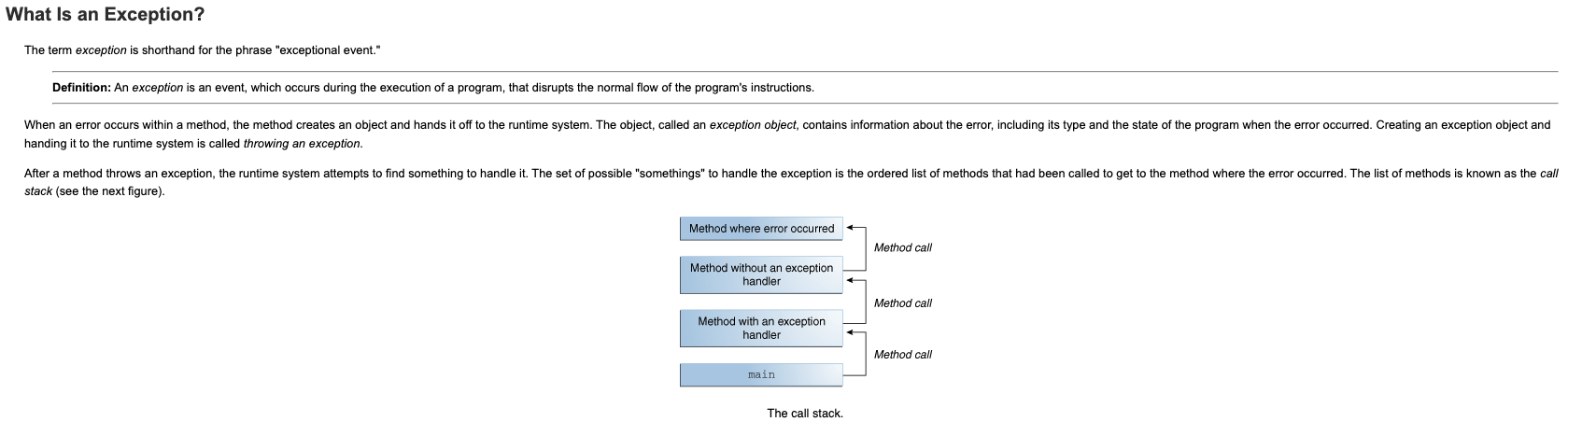
Exceptions 👀

Slide 5
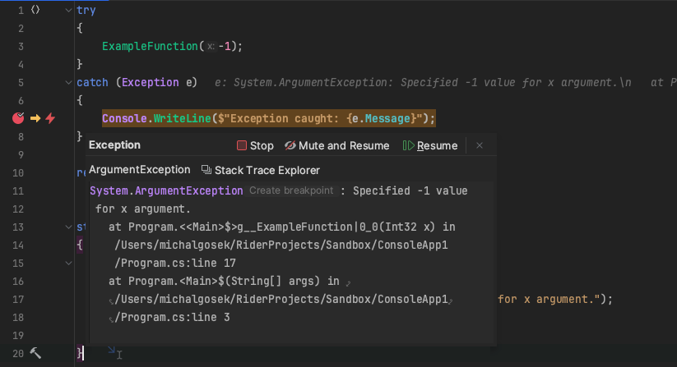
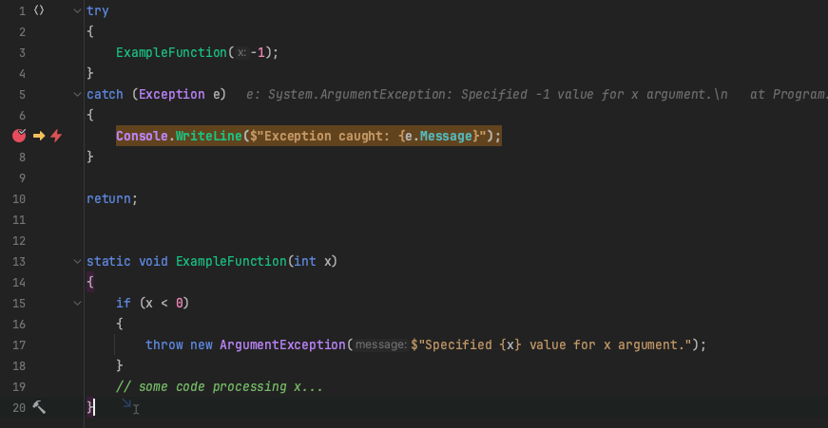
Exceptions - code example .NET

Slide 6
Exceptions vs no exceptions 🤔
Pros 🙂
No unnoticed application errors 🥷
Immediate end to the execution 👻
Exception middlewares 😃
Cons ☹️
Internal inspection of parts of third party libraries 🔍
Exception-driven application control-flow risk ⚠️
Encourage programmers to think less about errors 🤓

Slide 7
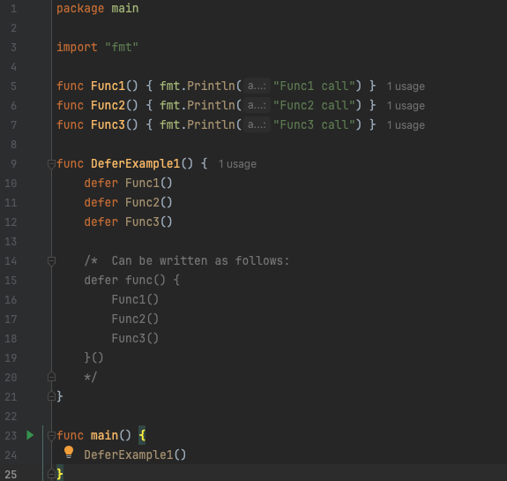
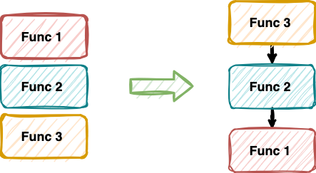
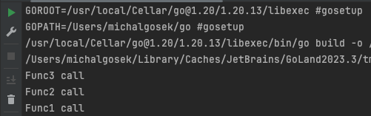
Defer, Panic and Recovery 😱
“A defer statement pushes a function call onto a list. The list of saved calls is executed after the surrounding function returns. Defer is commonly used to simplify functions that perform various clean-up actions.”
“Deferred function calls are executed in Last In First Out order after the surrounding function returns”.

Slide 8
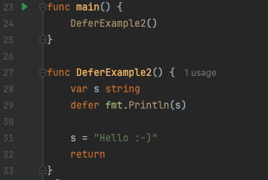
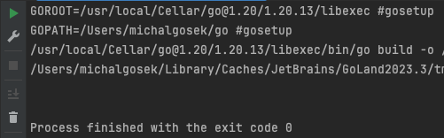

Defer, Panic and Recovery 😱
🤔
“A deferred function’s arguments are evaluated when the defer statement is evaluated”.

Slide 9
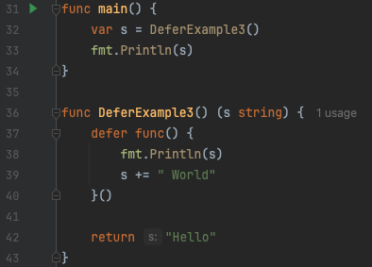
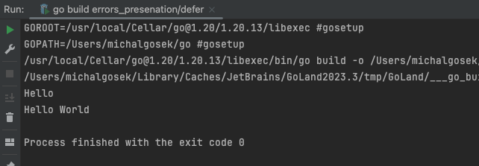
Defer, Panic and Recovery 😱
“Deferred functions may read and assign to the returning function named return values”

Slide 10
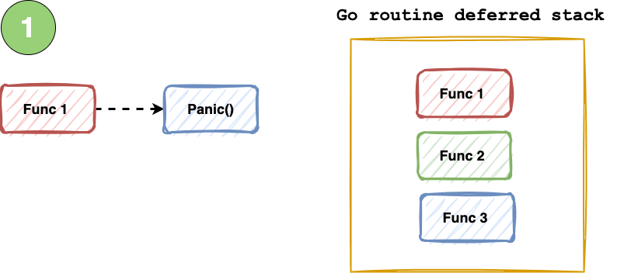
Defer, Panic and Recovery 😱

Slide 11
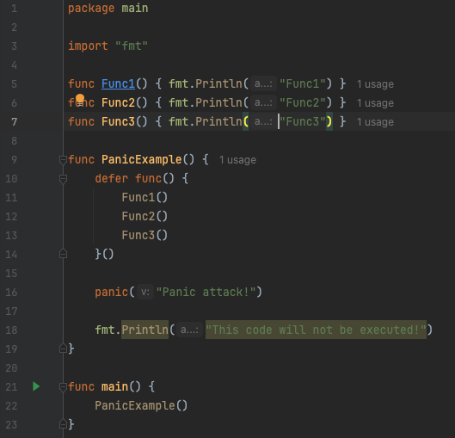
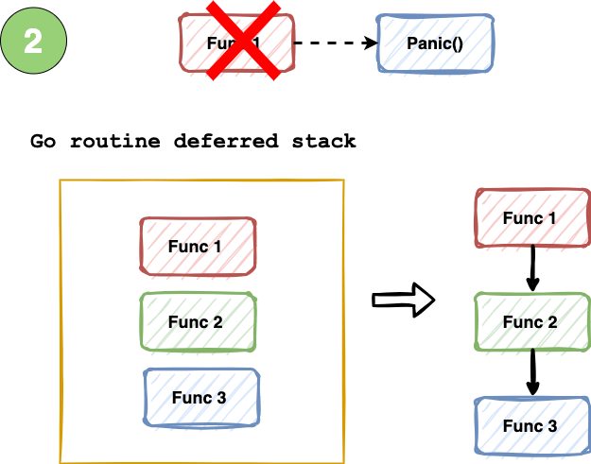
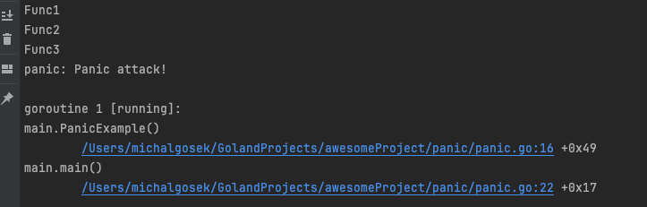
Defer, Panic and Recovery 😱

Slide 12
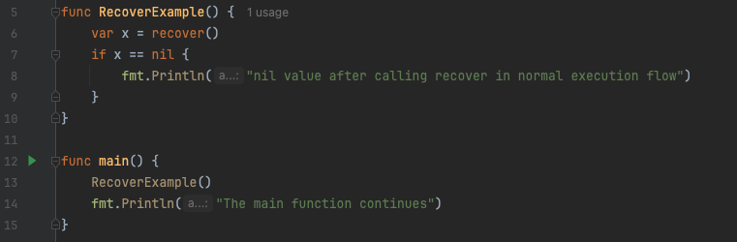
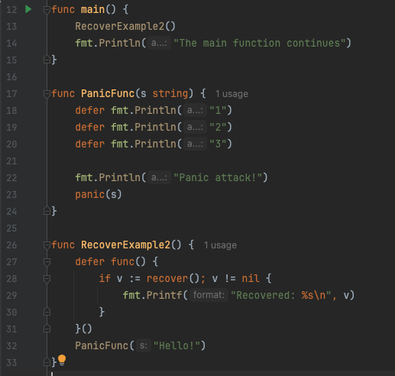
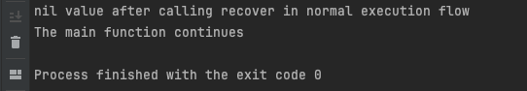
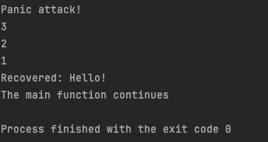
Defer, Panic and Recovery 😱

Slide 13
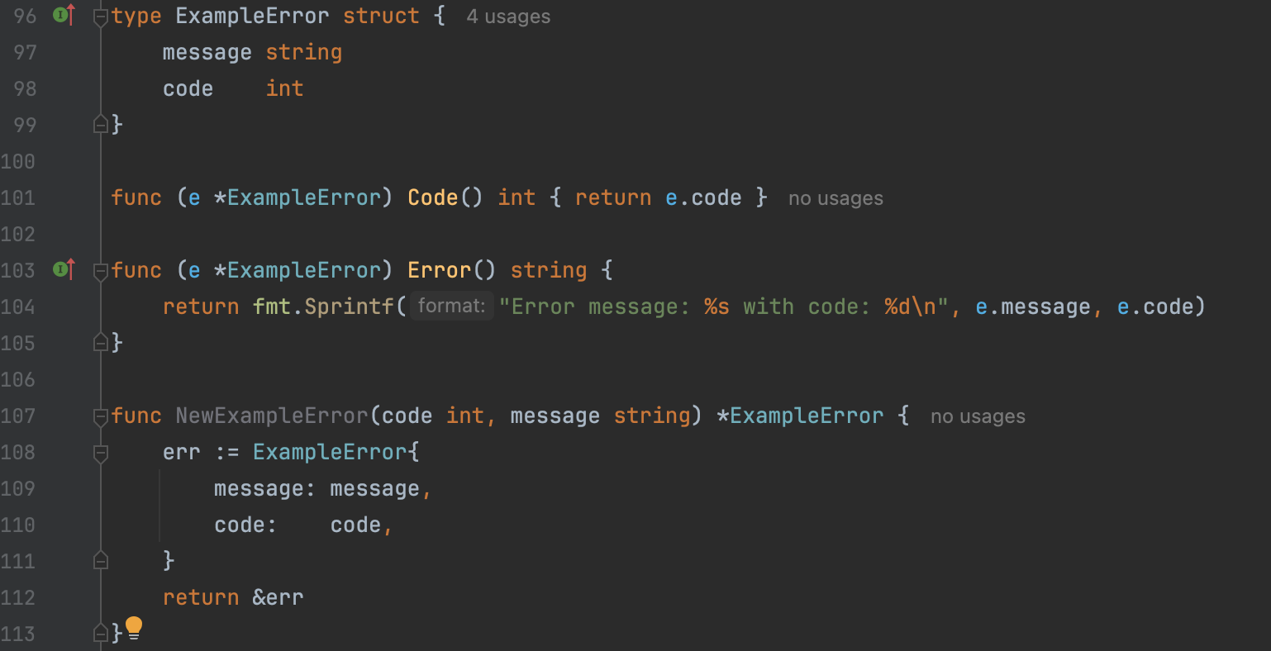
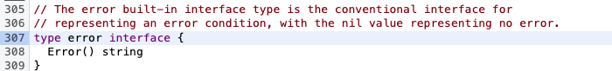
Errors in
“Errors are values. Values can be programmed, and since errors are values, errors can be programmed.” ~ Rob Pike

Slide 14
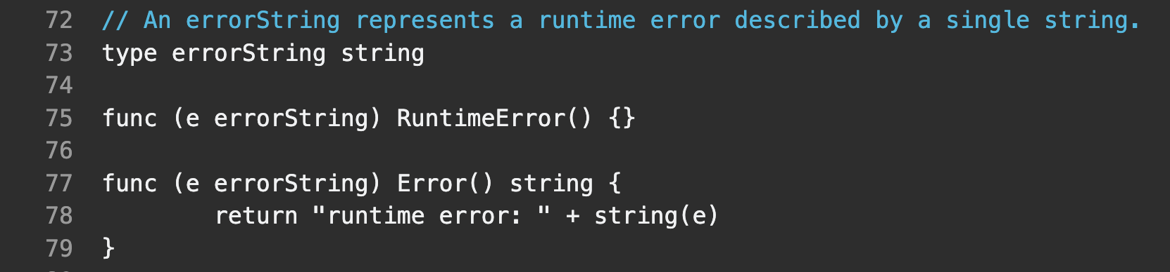
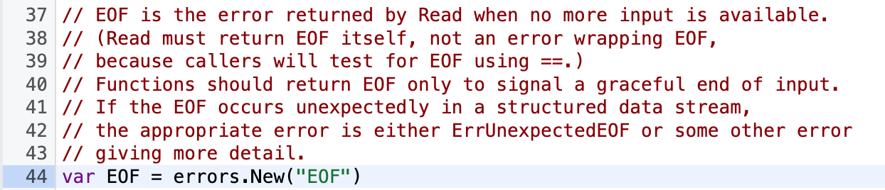
Built-in examples 🏗

Slide 15
Errors package API
API 📖
New - basic error creation
Join - merging multiple errors
Is - checks the error chain for the occurrence of the target
Wrap - wraps an error in another error
Unwrap - unpacks a wrapped error from another
As - error’s tree traversal to find the target and set it to found node's value

Slide 16
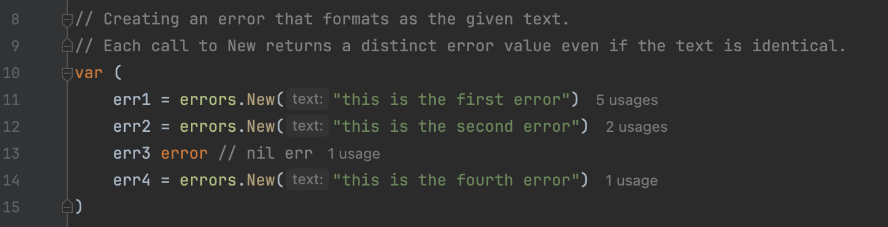
Errors package API
API 📖
New - basic error creation
Join - merging multiple errors
Is - checks the error chain for the occurrence of the target
Wrap - wraps an error in another error
Unwrap - unpacks a wrapped error from another
As - error’s tree traversal to find the target and set it to found node's value

Slide 17
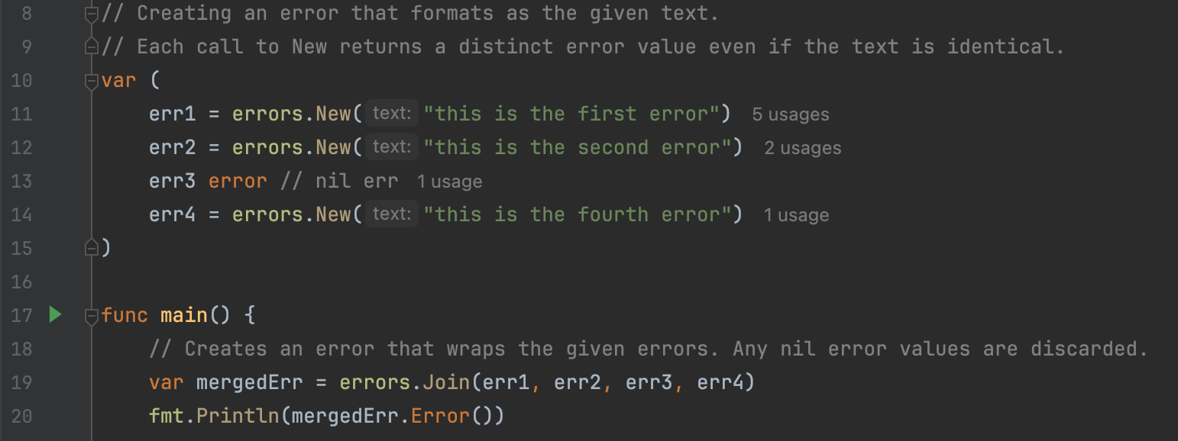
Errors package API
API 📖
New - basic error creation
Join - merging multiple errors
Is - checks the error chain for the occurrence of the target
Wrap - wraps an error in another error
Unwrap - unpacks a wrapped error from another
As - error’s tree traversal to find the target and set it to found node's value

Slide 18
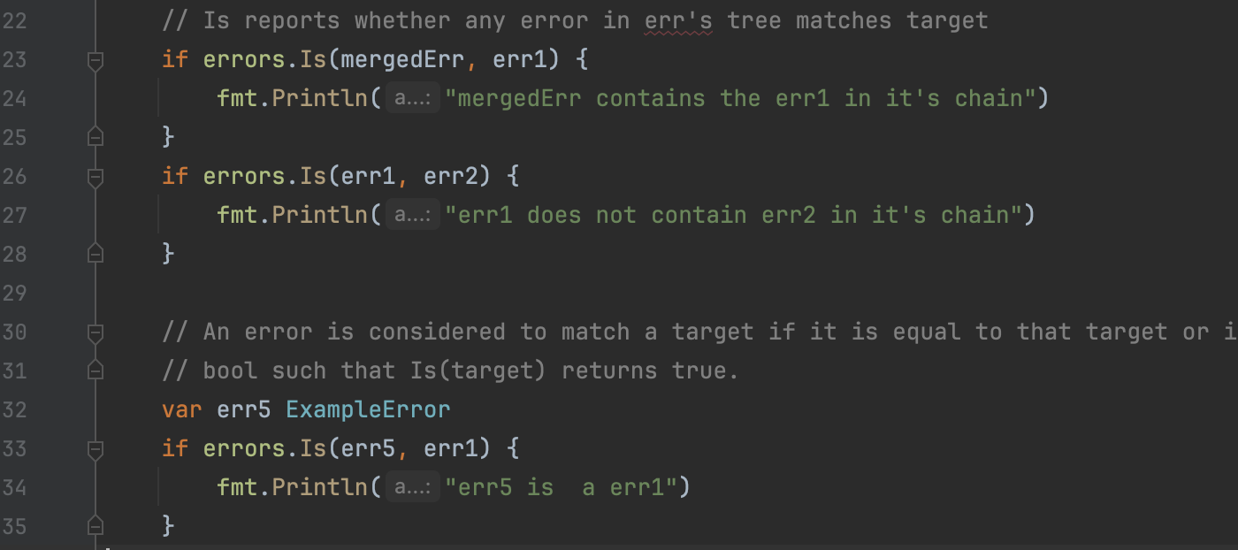
Errors package API
API 📖
New - basic error creation
Join - merging multiple errors
Is - checks the error chain for the occurrence of the target
Wrap - wraps an error in another error
Unwrap - unpacks a wrapped error from another
As - error’s tree traversal to find the target and set it to found node's value

Slide 19
Errors package API
API 📖
New - basic error creation
Join - merging multiple errors
Is - checks the error chain for the occurrence of the target
Wrap - wraps an error in another error
Unwrap - unpacks a wrapped error from another
As - error’s tree traversal to find the target and set it to found node's value

Slide 20
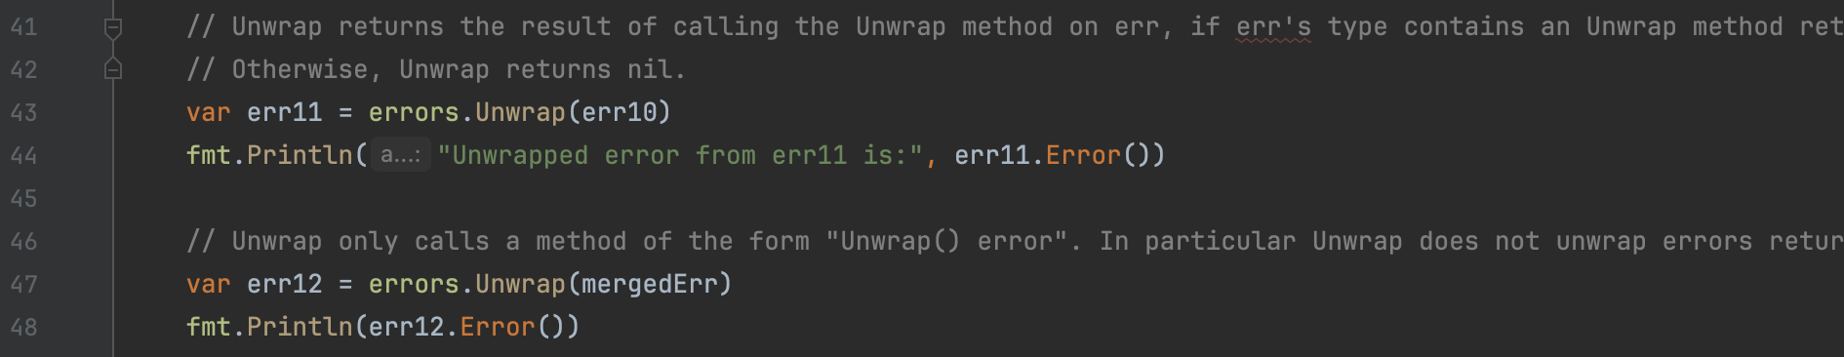
Errors package API
API 📖
New - basic error creation
Join - merging multiple errors
Is - checks the error chain for the occurrence of the target
Wrap - wraps an error in another error
Unwrap - unpacks a wrapped error from another
As - error’s tree traversal to find the target and set it to found node's value

Slide 21
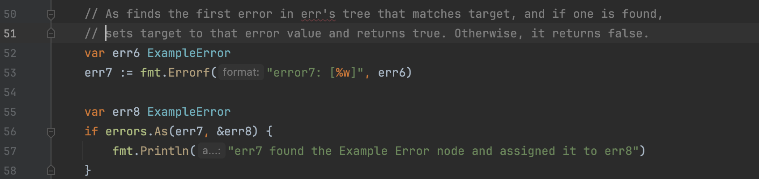
Errors package API
API 📖
New - basic error creation
Join - merging multiple errors
Is - checks the error chain for the occurrence of the target
Wrap - wraps an error in another error
Unwrap - unpacks a wrapped error from another
As - error’s tree traversal to find the target and set it to found node's value

Slide 22
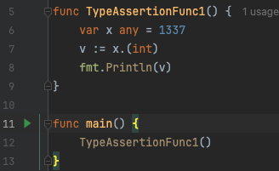
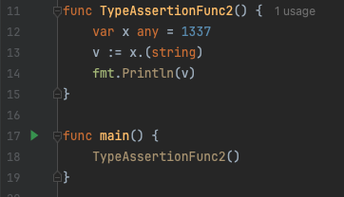
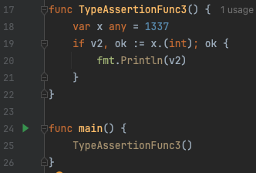
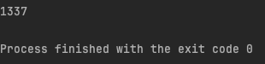
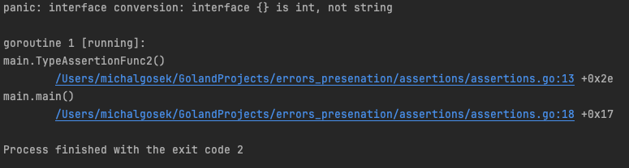
Assertions 👮🏻‍♂️
“A type assertion provides access to an interface value's underlying concrete value.”
t := i.(T)

Slide 23

Let’s look at the code example 💾

Slide 24
References 📚
Software error
https://www.lawinsider.com/dictionary/software-error
https://en.wikipedia.org/wiki/Software_bug
Exceptions
https://docs.oracle.com/javase/tutorial/essential/exceptions/definition.html
https://learn.microsoft.com/en-us/dotnet/standard/exceptions/
Exceptions vs no exceptions
https://go.dev/doc/faq#exceptions
Defer, Panic and Recovery
https://go.dev/blog/defer-panic-and-recover
https://gobyexample.com/defer
https://gobyexample.com/recover
https://gobyexample.com/panic
https://go.dev/tour/basics/7
Errors in Go
https://cs.opensource.google/go/go/+/refs/tags/go1.21.6:src/builtin/builtin.go;l=307
https://go.dev/blog/errors-are-values
Built in examples
https://cs.opensource.google/go/go/+/refs/tags/go1.21.6:src/io/io.go;l=44
https://go.dev/src/runtime/error.go?s=3043:3059
Errors package API
https://pkg.go.dev/errors
https://gobyexample.com/errors
Assertions
https://go.dev/tour/methods/15
https://go.dev/doc/effective_go#type_switch
Articles
https://dave.cheney.net/2016/04/27/dont-just-check-errors-handle-them-gracefully
https://dave.cheney.net/2014/12/24/inspecting-errors
Gophers
https://github.com/MariaLetta/free-gophers-pack
https://github.com/ashleymcnamara/gophers

